Slide 1
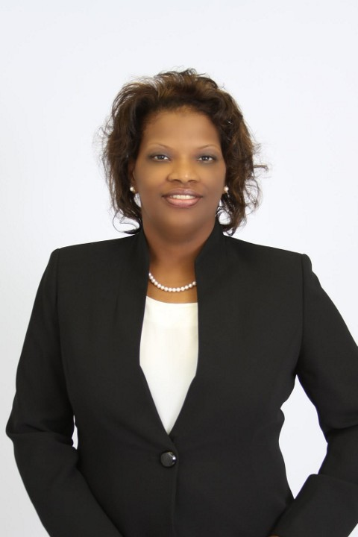
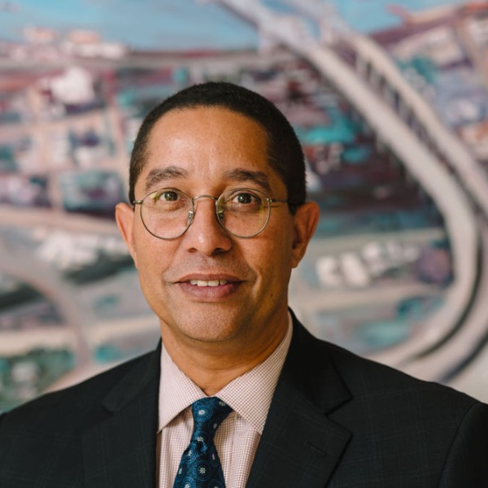
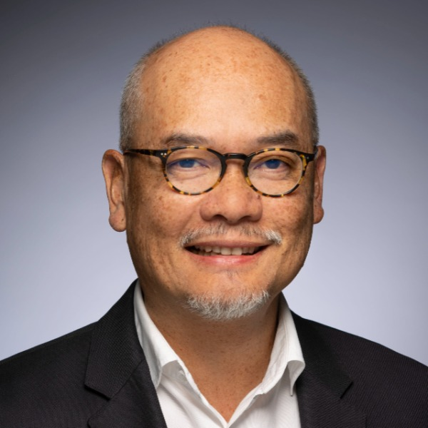
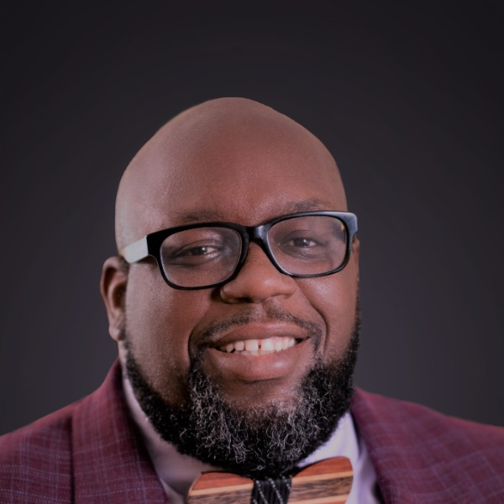
Welcome To Racial Equity In The Fundraising Profession
Germaine Mitchell
Moderator
Kenneth St. Charles, MBA, PhD
Panelist
Linh Nguyen, BA
Panelist
Ernest Lewis, III MBA
Panelist

Slide 2
Panel Discussion (60 minutes)
Each Panelist Will Share Their Understanding Of Racial Equity
Each Panelist Will Share How They Uphold Racial Equity
Each Panelist Will Share How They Intend To Perpetuate Racial Equity
Audience Questions (30 minutes)

Slide 3
Kenneth St. Charles, MBA, PhD
Dr. Kenneth St. Charles currently serves as the Vice President for Philanthropy of the Greater New Orleans Foundation. An accomplished fundraiser primarily in the nonprofit, higher education, and secondary education arenas, he has personally raised more than $160 million over his 30-year fundraising career. He most recently served as President/CEO of St. Augustine High School in New Orleans from 2016 – 2021.

Slide 4
Linh Nguyen, BA
Linh leads racial equity efforts for Lumina Foundation, a private foundation in Indianapolis committed to making opportunities for learning beyond high school available to all. He works to embed equity in Lumina’s grantmaking and operations and nurtures the foundation’s culture to increase diversity, improve inclusion, and eliminate racial disparities. A recognized leader in impact strategy and organizational development, Linh previously served as chief operating officer at the W.K. Kellogg Foundation in Battle Creek, Mich.

Slide 5
Ernest lewis, III MBA
Ernest Lewis III has a diverse background in the areas of management, fund development, media, literacy, arts administration, and community development. Ernest has acquired varied experience in developing and shaping signature programming focusing on basic needs, disaster recovery, youth development, adult and family literacy, workforce development, and art education. Ernest served as President and CEO of the Adult Education Center in Pearland, TX until early 2022 and is currently Senior Director, Economic Initiatives at BakerRipley.

Slide 6
Audience questions (30 minutes)
Understanding Of Racial Equity
Upholding Racial Equity
Perpetuating Racial Equity

Slide 7
Thank You for your attendance and participation in Racial Equity In The Fundraising Profession
Germaine Mitchell
Moderator
Kenneth St. Charles, MBA, PhD
Panelist
Linh Nguyen, BA
Panelist
Ernest Lewis, III MBA
Panelist

